Slide 1
Cab fare Prediction
Manoj Patil M

Slide 2
Problem Statement
You are a cab rental start-up company. You have successfully run the pilot project and now want to
launch your cab service across the country. You have collected the historical data from your pilot project
and now have a requirement to apply analytics for fare prediction. You need to design a system that
predicts the fare amount for a cab ride in the city.

Slide 3
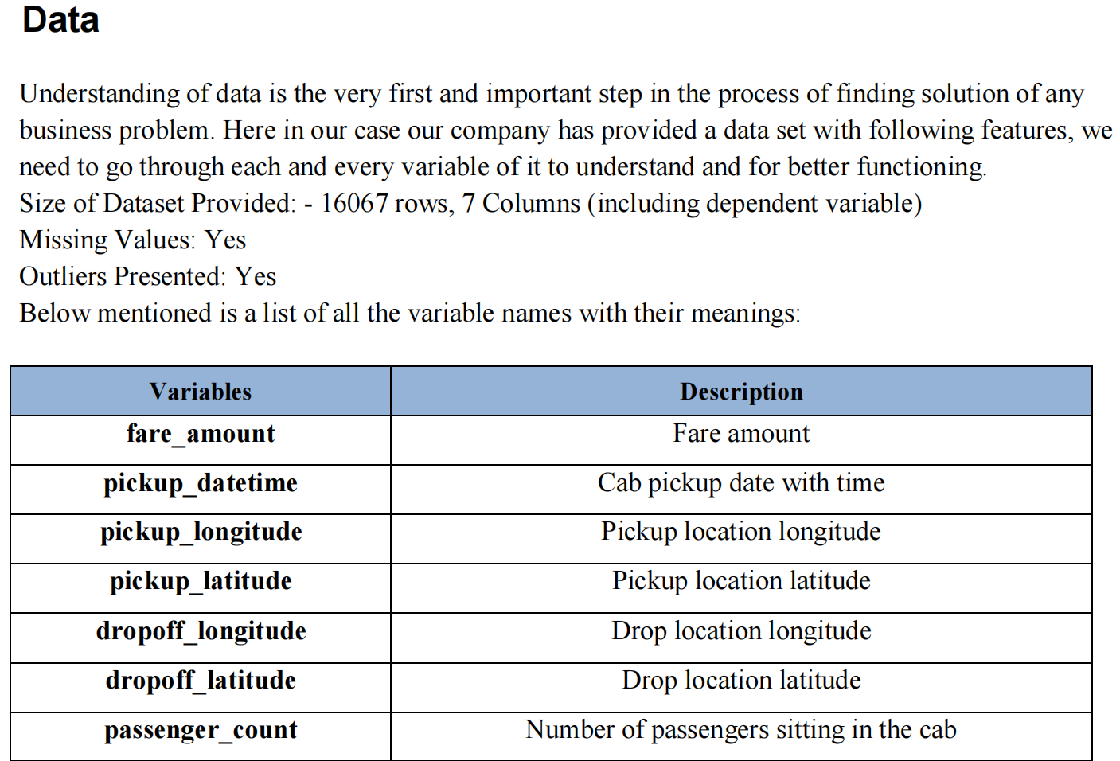

Slide 4
Data exploration and Cleaning
As we know we have some negative values in fare amount so we have to remove those values.
Passenger count would be max 6 if it is a SUV vehicle not more than that. We have to remove
the rows having passengers counts more than 6 and less than 1.
There are some outlier figures in the fare (like top 3 values) so we need to remove those.
Latitudes range from -90 to 90. Longitudes range from -180 to 180. We need to remove the rows
if any latitude and longitude lies beyond the ranges.

Slide 5
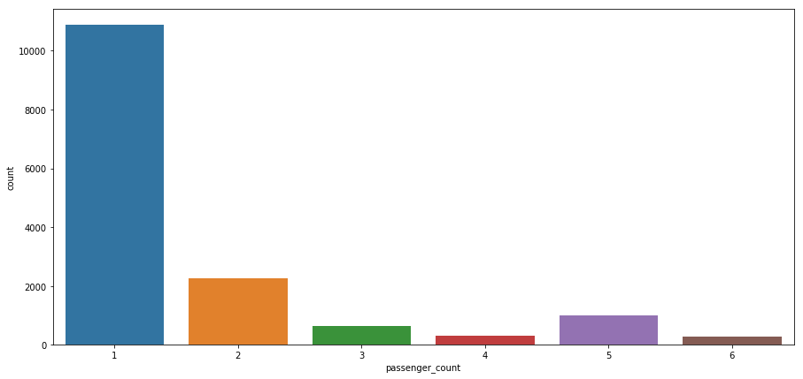
EDA
1. Number of passengers and fare
We can see in below graph that single passengers are the most frequent travelers, and the highest fare
also seems to come from cabs which carry just 1 passenger.

Slide 6
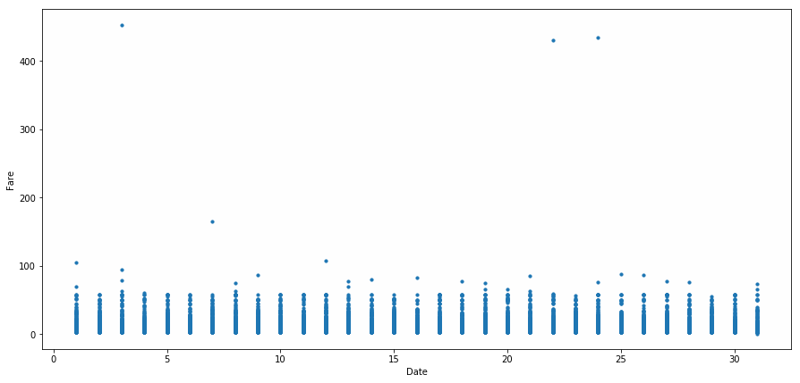
2. Date of month and fares
The fares throughout the month mostly seem uniform.

Slide 7
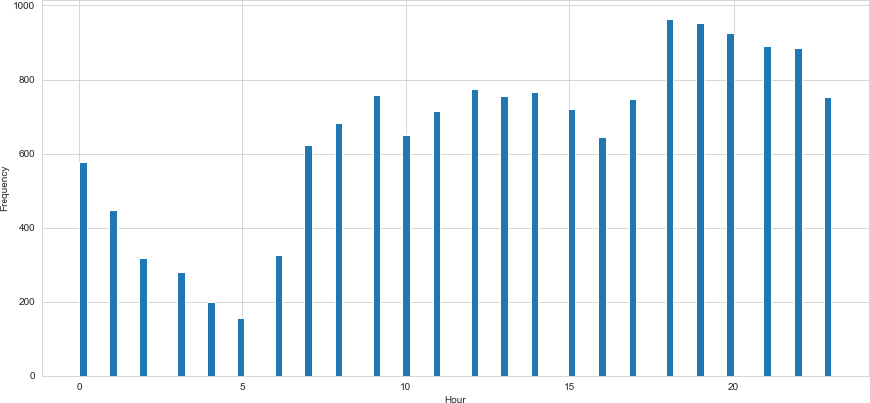
3. Hours and Fares
• During hours 6 PM to 11PM the frequency of cab boarding is very due to peak hours
• Fare prices during 2PM to 8PM is bit high compared to all other time might be due to high demands.

Slide 8
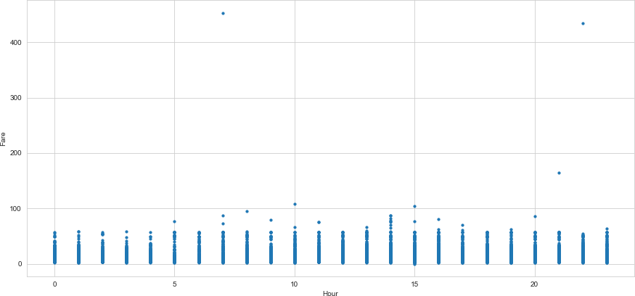

Slide 9
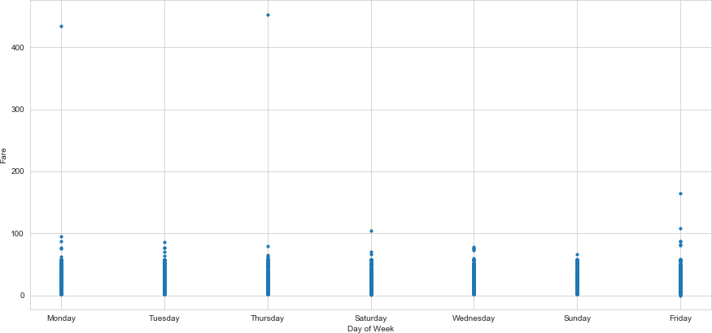
Week Day and fare
Cab fare is high on Friday, Saturday and Monday, may be during weekend and first day of the
working day they charge high fares because of high demands of cabs.

Slide 10
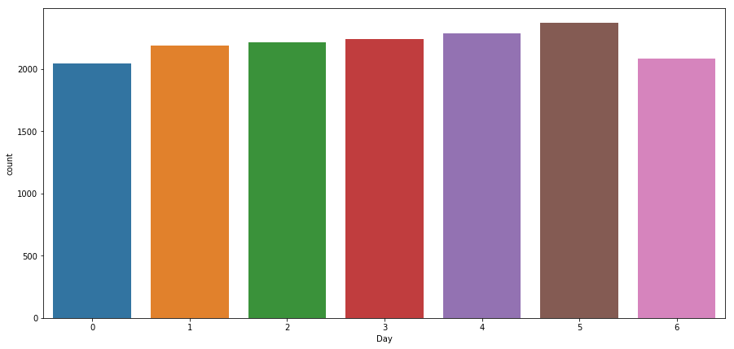
Impact of Day on the Number of Cab rides :

Slide 11
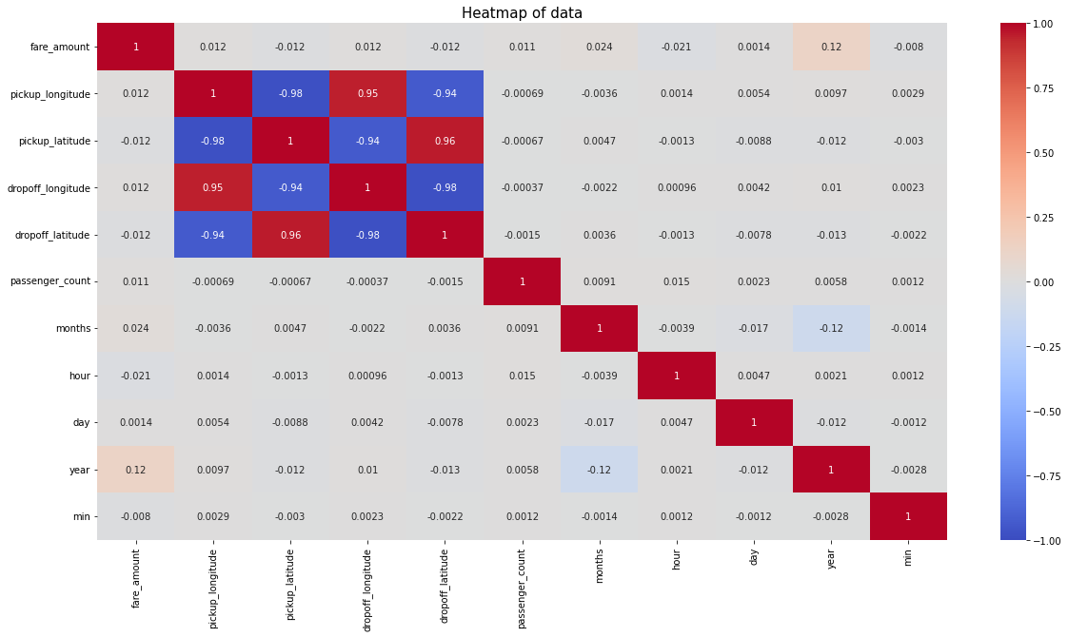
Checking correlation of all the features in our dataset

Slide 12
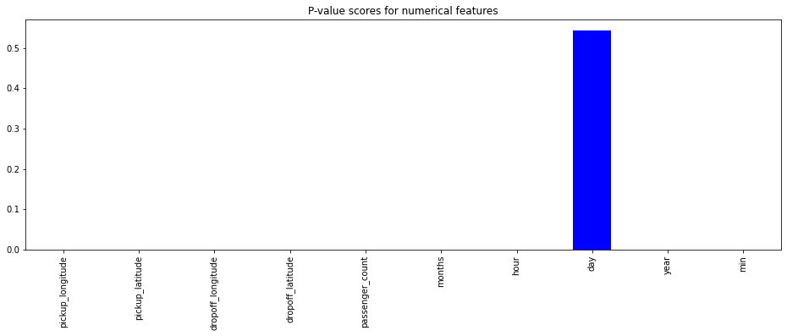
Feature selection
from anova technique we can observe day column is not required for predicting dependent variable

Slide 13
Feature engineering
def distance(x):
you = "{0},{1}".format(x['pickup_latitude'],x['pickup_longitude'])
me = "{0},{1}".format(x['dropoff_latitude'],x['dropoff_longitude'])
km = geodesic(me,you).kilometers
return km
#extracting date month time from date time columns
df["dates"]=pd.to_datetime(df['pickup_datetime'])
df['months']=df["dates"].dt.month
df['hour']=df["dates"].dt.hour
df['day']=df["dates"].dt.day
df['year']=df["dates"].dt.year
df['min']=df['dates'].dt.minute

Slide 14
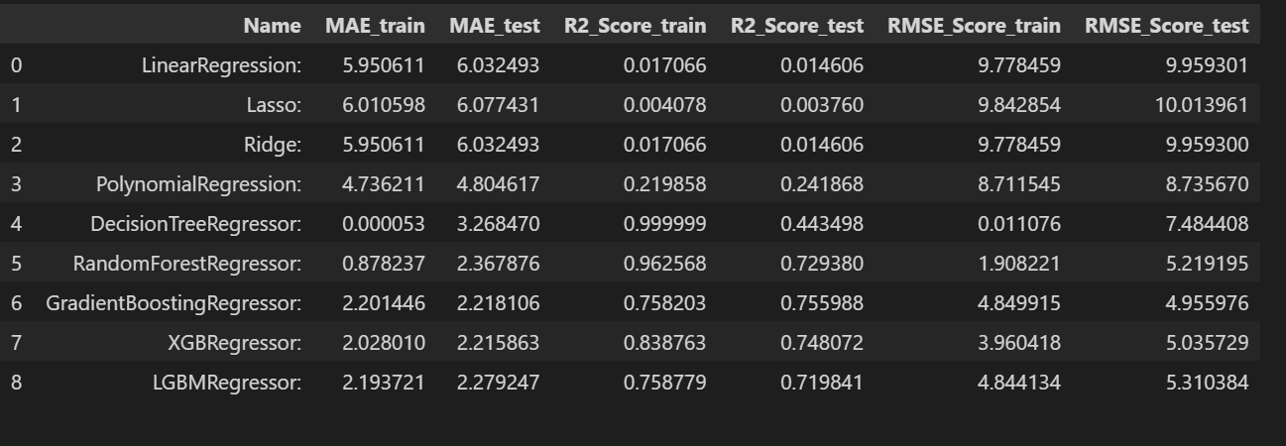
Model selection

Slide 15
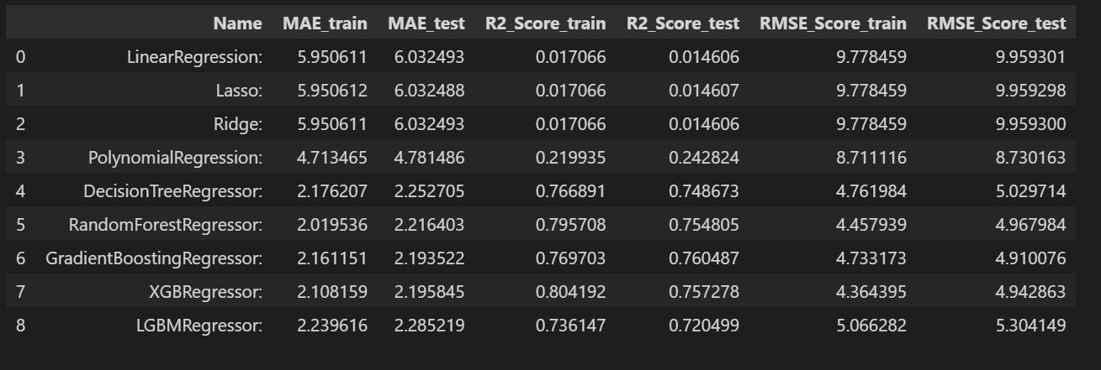
Hyper parameter tuning

Slide 16
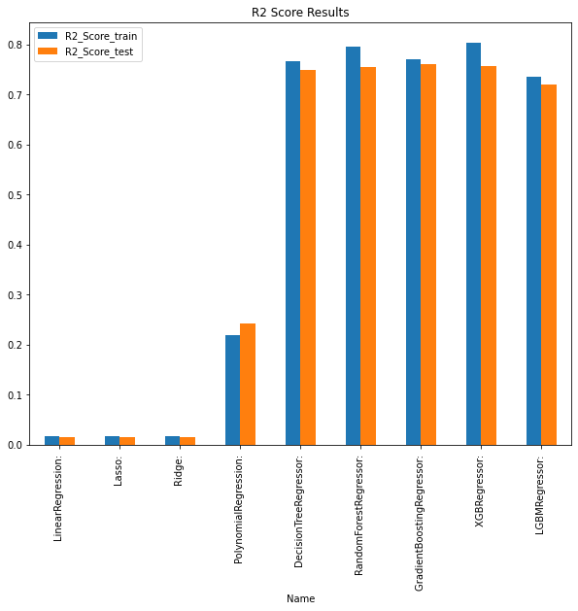

Slide 17
Conclusion
*XGBRegressor is performing better having 0.8 r2 value for train dataset 0.76 r2 value for test dataset
*We can observe from dataset that single passengers are the most frequent travelers, and the highest fare
also seems to come from cabs which carry just 1 passenger
*The fares throughout the month mostly seem uniform
*During hours 6 PM to 11PM the frequency of cab boarding is very due to peak hours
*Fare prices during 2PM to 8PM is bit high compared to all other time might be due to high
demands.
*Cab fare is high on Friday, Saturday and Monday, may be during weekend and first day of the
working day they charge high fares because of high demands of cabs.

